Slide 1

Exploratory Data Analysis
G2M insight for Cab Investment firm
07/22/2022

Slide 2

Agenda
Problem Statement
Data Processing
EDA
EDA Summary
Recommendations

Slide 3
Problem Statement –G2M(cab industry) case study
XYZ is a private equity firm in US. Due to remarkable growth in the Cab Industry in last few years and multiple key players in the market, it is planning for an investment in Cab industry.
Objective : Provide suggestions regarding to this investment
The outline of our analysis:
Data Processing
Find the better company using EDA
Other analysis regarding our investment through EDA
Recommendations for investment

Slide 4
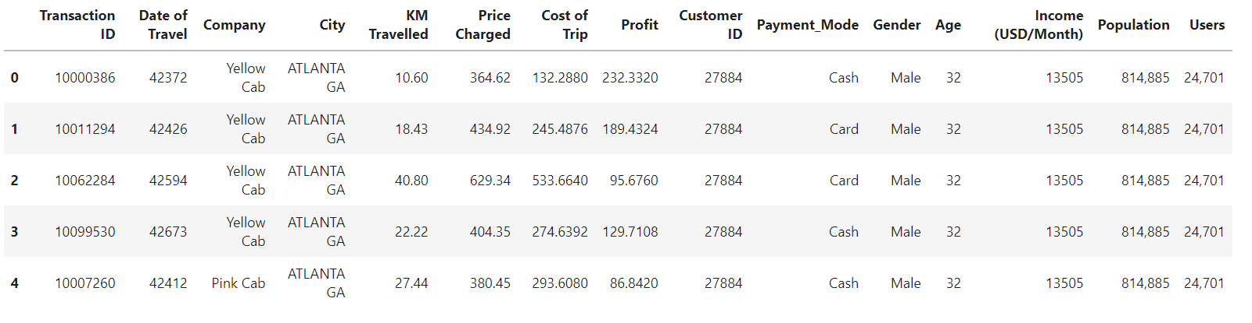
Data Processing
Timeframe: 2016.01.01 – 2018.12.31
Companies: Yellow Cab and Pink Cab
Number of data points: 359,292
No outliers or duplicate values were observed
A glance of the final merged dataset:

Slide 5
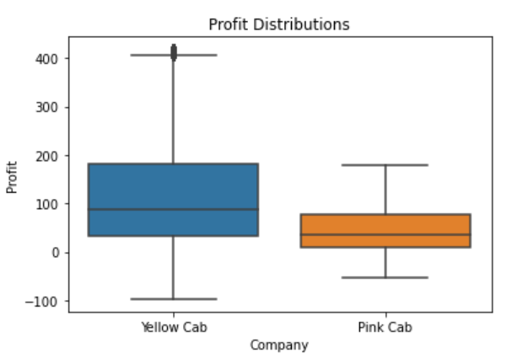
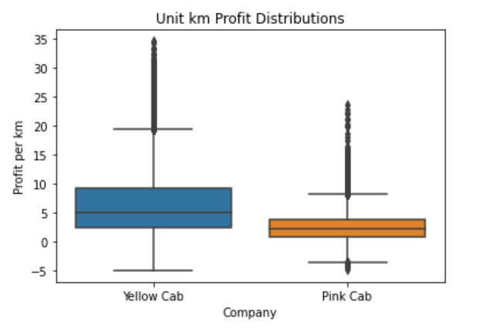
Profit Distribution
Yellow Cab is more profitable than Pink Cab both overall and per kilometer.

Slide 6
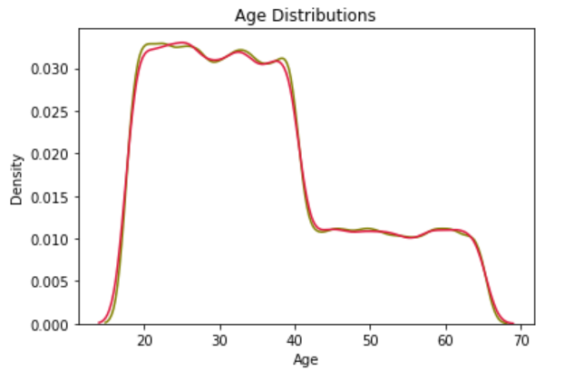
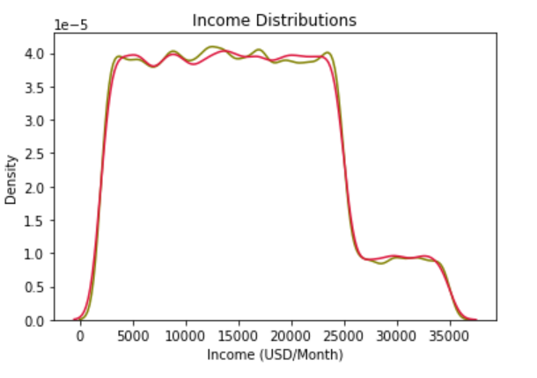
Customer Distribution
The two companies have very similar customer groups regarding age and income.

Slide 7
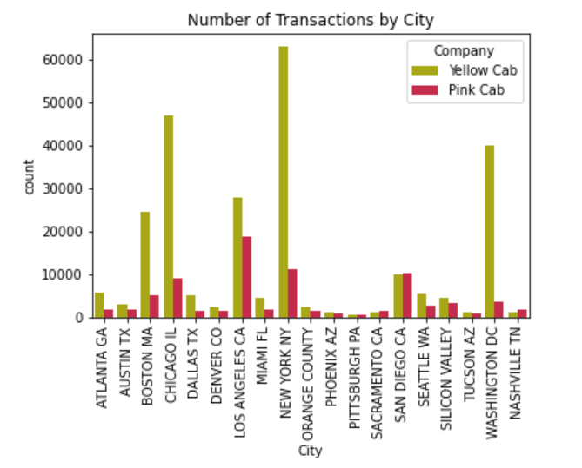
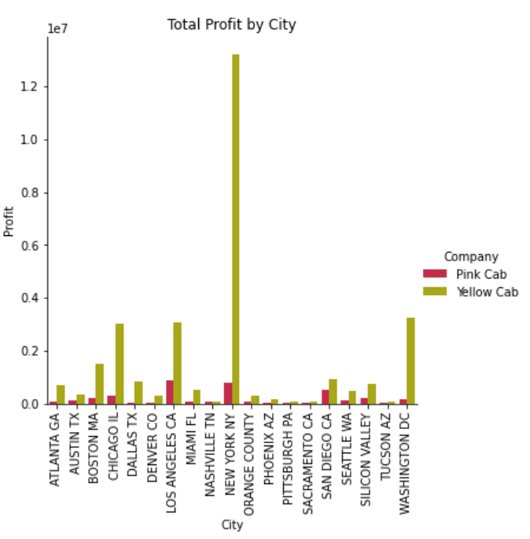
Group by Cities
Yellow Cab has more transactions and comparably larger profit in almost all cities. Therefore, Yellow Cab is our choice for investment.

Slide 8
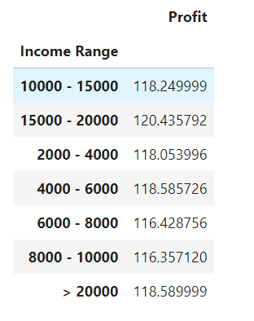
Ideal Range of Customer Income
There is no obvious difference between profit made from a single trip and income range of customers. Customer of all income levels pay around 118 USD for a single trip on average.

Slide 9
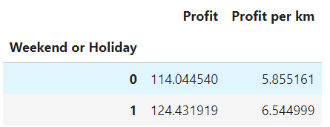
Profit Increment on Weekend
A boost of total profit by 9.1% and unit profit by 11.8% for weekend and holidays than weekdays.

Slide 10
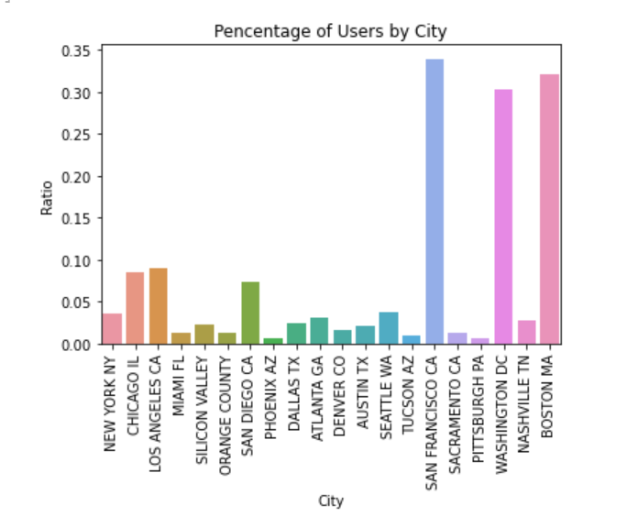
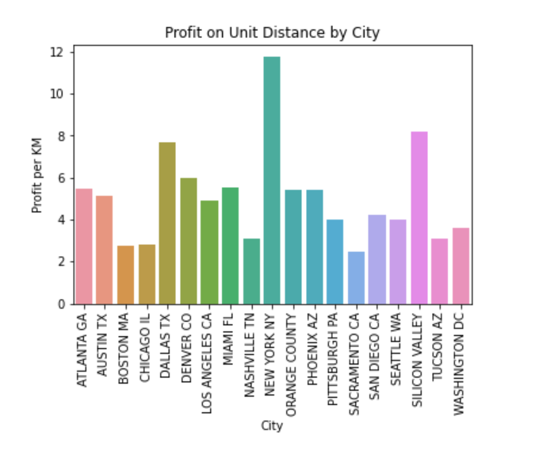
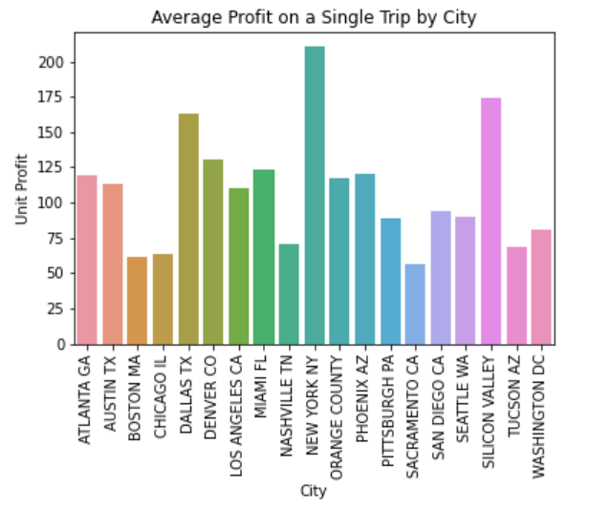
What are some good cities to invest?
San Francisco, Boston, and DC, have about 30% of the total population as cab users. These cities would be the best for advertising.
New York City, Silicon Valley, and Dallas are the three cities with the most unit profit (both per trip and per kilometer).

Slide 11
What are some good cities to invest?
It’s better to invest in larger cities as these provide more profit both on a single trip and annually.
Also, there're more white collars in larger cities, so it's not likely that our investment would fail. However, data related to cost of advertisement and competitions (these are usually harsher in larger cities) are not provided. Thus, this result still needs more advanced research.

Slide 12
Conclusion – Our Recommendations
In this study, EDA was used to identify a better cab company to invest among Yellow Cab and Pink Cab. Several factors were taken into account, such as profit distribution, customer attributes, and characteristics grouped by city. The two companies has similar customer composition, but Yellow Cab outweighs Pink Cab in total profit, per kilometer profit, and almost in all cities. Therefore, we suggest to invest in Yellow Cab. And finally, investing in the few largest cities gives the most payback according to our plots.

Slide 13
Thank You

